Slide 1
NEW SIMPLIFIED PLANNING ZONE CONSULTATION JULY 2024
slough.gov.uk/planningpolicy

Slide 2
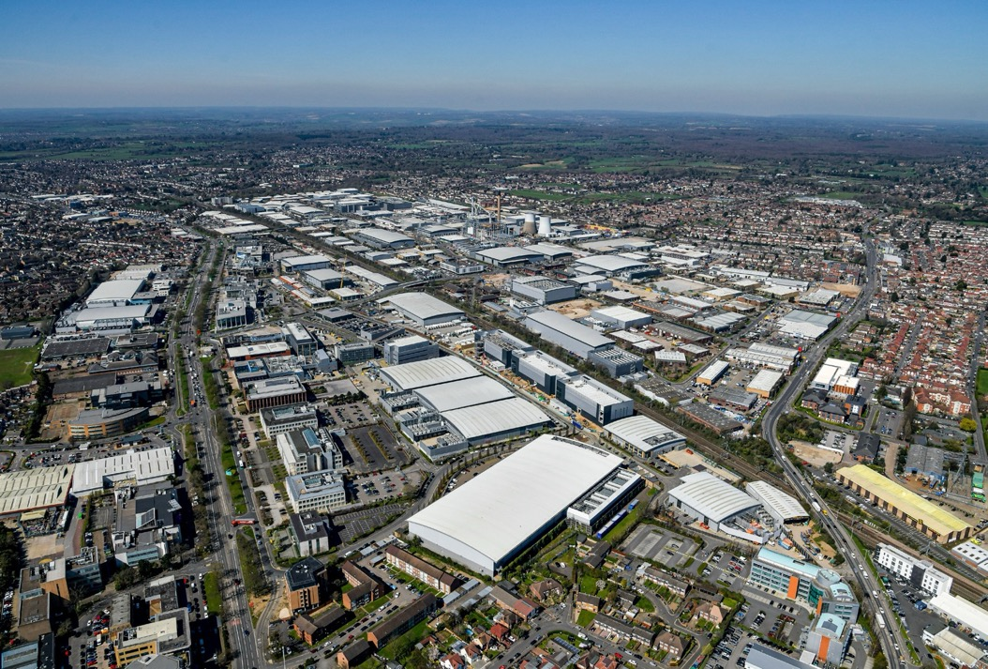
CONTENTS
INTRODUCTION
Slough Borough Council (SBC), working with SEGRO, have published a draft of the new Simplified Planning Zone (SPZ) scheme for Slough Trading Estate.
An SPZ has already been operating at the Estate since 1995 and this new SPZ is proposed to replace it for the next 10 years.
Introduction
Slough Trading Estate
The Simplified Planning Zone
Attracting and retaining industrial businesses
Permitted building heights
Design quality
Landscaping & biodiversity
Building sustainability measures
Traffic & movement
Sustainable infrastructure
A skilled & sustainable workforce
This Non-Technical Summary (NTS) has been prepared for Slough residents, businesses and community groups to learn more about the draft new SPZ scheme for Slough Trading Estate in simple, non-technical language and ensure the proposals benefit people working and living in Slough.
Local residents, business owners and community stakeholders are invited to have your say on the revised proposals.
You can provide your feedback by visiting SBC’s consultation website online at the details below:
slough.gov.uk/planningpolicy
The consultation period for the draft SPZ closes on Monday 19 August 2024 (11.59pm).

Slide 3
SLOUGH TRADING ESTATE
Together SEGRO – an event for Slough Trading Estate customers to come together, share knowledge, and collaborate.
For over 100 years, Slough Trading Estate has played an important role in Slough’s economic success. The Slough Trading Estate began as a military vehicle repair depot in 1920 and is now Europe’s largest industrial estate in single ownership.
SEGRO is a UK Real Estate Investment Trust and are long-term owners and managers of Slough Trading Estate.
The Simplified Planning Zone (SPZ) gives Slough a competitive advantage by making it quicker and easier for businesses to locate on the Slough Trading Estate. The SPZ provides businesses with the speed, certainty and confidence needed to invest in the town, which helps to maintain a healthy economy. These businesses not only create jobs for local people and invest in the local economy but, along with SEGRO, contribute £49 million a year in Business Rates which is helping to fund essential local services.
Today, Slough Trading Estate is home to 350 businesses which employ over 15,000 people.
The SPZ will help create a modern and sustainable industrial estate that meets the needs of SEGRO customers, their employees and the community of Slough.
The SPZ allows Slough Trading Estate to continue to respond quickly to changes in the economy that are driven by technological advancements, climate change, and globalisation to maintain its position as a leading business destination for investment and business growth.
The vision for the Slough Trading Estate is to provide the best place in the UK for business to thrive.
A place of excellence in design, functionality, and sustainability. A clean, green, safe and secure environment.
A hotspot for employment and education. A focus on health and well-being for Slough’s community to enjoy.
A home for a diverse range of businesses and a cluster of technological innovation.
The Slough Trading Estate will continue to lead and evolve and will remain focussed on providing a legacy for the people of Slough.

Slide 4
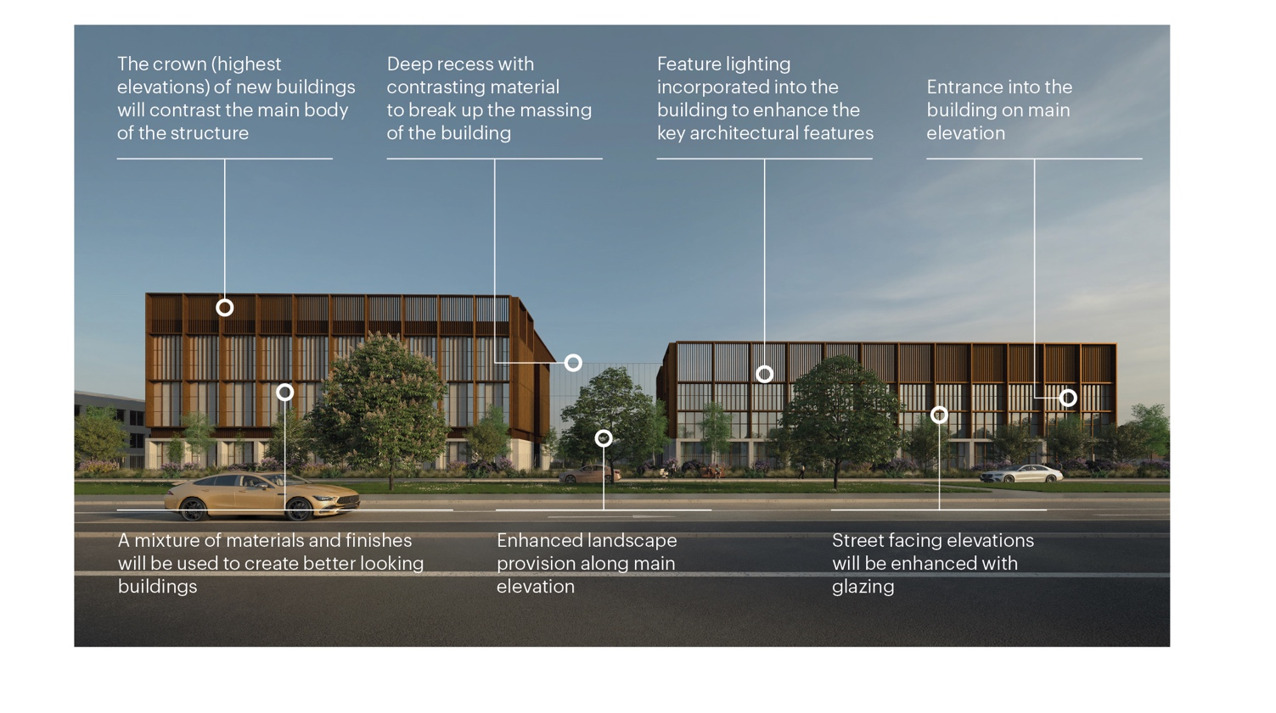
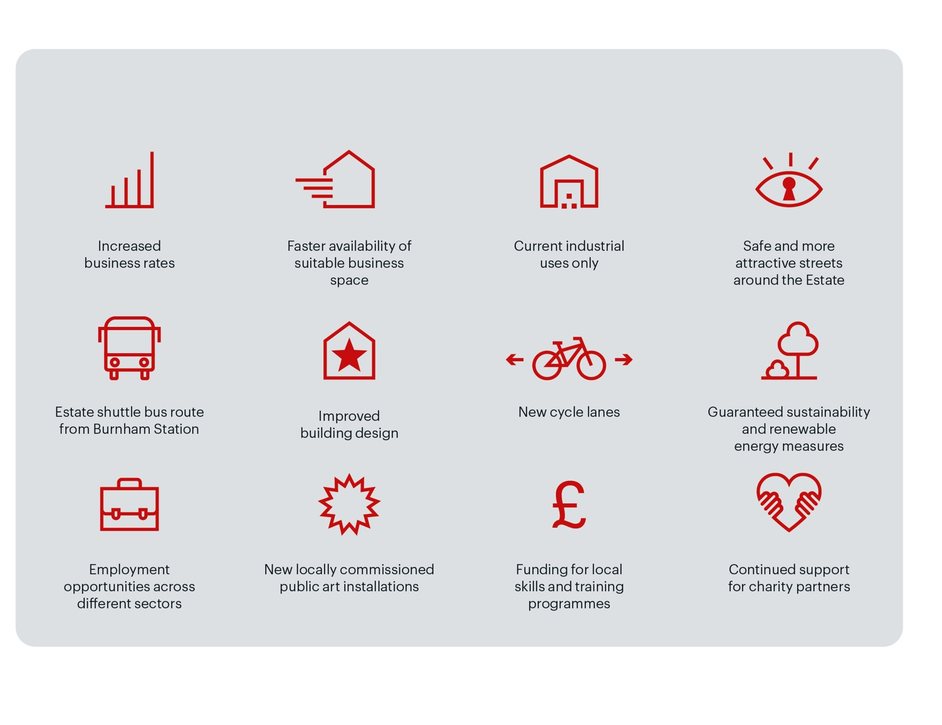
THE SIMPLIFIED PLANNING ZONE
Compliance with the SPZ will be governed by the following documents which are available to view and comment on as part of this consultation:
SPZ Scheme Document
The SPZ Scheme document includes a description of development and a list of permissible uses for the new SPZ such as light industrial, manufacturing, storage and distribution, research and development, and data centres.
Parameter plans*
The new SPZ includes several parameter plans, including:
SPZ Boundary Plan
Street Type and Sub-Zone Plan
Building Heights Plan
Highways Safeguarding Plans
Areas of Archaeological Potential
Design Code
A Design Code is a set of simple, concise, design requirements which set principles for new development. It ensures development is regulated to deliver high-quality schemes which are well integrated into their surroundings.
Sustainability Requirements
The sustainability requirements will include environmental, biodiversity and well-being parameters to achieve long-term success.
Travel Plan
A travel plan is a long-term strategy which aims to encourage people to use alternatives to cars to travel to and from the Estate.
Planning conditions
Planning conditions are additional measures attached to the SPZ to secure quality development, and avoid negative
impacts on people and the environment.
Demolition / Construction Environmental Management Plan – (DCEMP)
A DCEMP outlines how SEGRO will minimise any negative
environmental impacts of construction projects and comply
with any relevant environmental legislation.
Construction Traffic Management Plan (CTMP)
A CTMP outlines steps to safely manage the flow of traffic around a construction site, including routing of construction vehicles.
Written Scheme of Investigation (WSI)
The WSI identifies areas where further archaeological investigation is required within the boundary of the SPZ Scheme.
All documents are available at slough.gov.uk/planningpolicy
Indicative design within the SPZ parameters
Since 1995, the Slough Trading Estate has benefited as a Simplified Planning Zone (SPZ), which has played a key role in stimulating and encouraging economic growth, investment and job creation through simplifying the Planning process. The SPZ speeds up redevelopment on the Estate by removing the need for repetitive planning applications, covering the same range of planning issues, which saves time and cost for new businesses looking to invest in the Estate. It also benefits Slough Borough Council by reducing the resources needed to manage planning and development in this vital employment hub. However, an SPZ does not mean an abandonment of acceptable standards of development, sustainability or care for the amenities around the Estate’s buildings. These matters would still be addressed in the new SPZ while offering certainty and flexibility to businesses.
Over the last 10 years, major local businesses such as Octopus Energy, John Crane, CLEAN Linen Services, Bidfood, Jaguar Land Rover and many more have all occupied industrial space which has been delivered under the SPZ, unlocking new investment and creating jobs.
Slough Trading Estate is one of only two business locations in England that operates a Simplified Planning Zone. It gives Slough a competitive advantage by giving SEGRO and its customers the confidence to invest in the town and by creating a vibrant industrial destination.
How does the SPZ work?
The Simplified Planning Zone is a planning tool which simplifies the planning approval process for new industrial buildings. The new SPZ would grant advanced planning permission for certain types of development such as industrial, warehouse, research & development and data centre uses within a designated area over a period of 10 years.
The SPZ achieves this by setting planning conditions, agreed by Slough Borough Council, for new buildings in advance. Any development which meets these conditions does not have to go through the normal planning process. Buildings which don’t meet these criteria still have to apply for planning permission in the normal way.
The benefits of the new SPZ
* Parameter plans illustrate how the SPZ requirements will be applied in different areas of the Estate

Slide 5
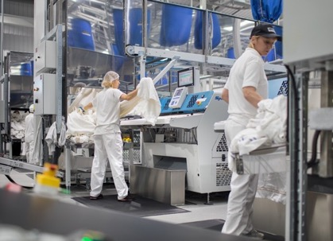
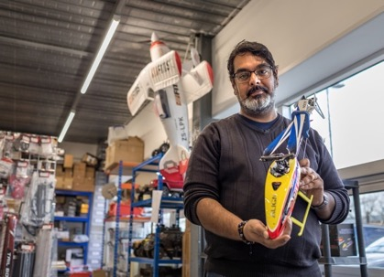
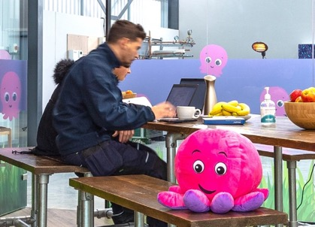
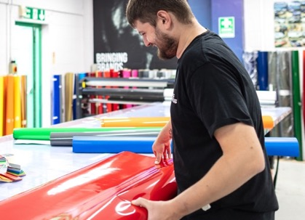
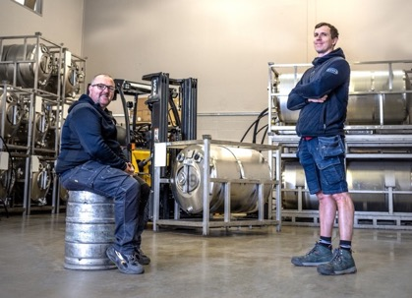
ATTRACTING AND RETAINING INDUSTRIAL BUSINESSES
An area in high demand
There remains high demand for modern sustainable industrial space from UK and international businesses operating in technology-led sectors such as high-value manufacturing, data and communications services, and food production. The SPZ will allow the Slough Trading Estate to respond quickly and attract new investment from these sectors into Slough to support their growth and net zero aspirations.
Developments that support retail, food and drink and commercial services (banks, post office, etc) uses are restricted to the Buckingham Centre, which is located at the heart of the Estate.
These uses provide essential services and amenities that will support a thriving business destination that is home to 350 customers and over 15,000 workers.
Development of homes and offices will not be allowed under the permitted uses.
The dynamic and varied uses allowed under the current SPZ will be safeguarded and retained in the new SPZ, allowing the Estate to continue to thrive. These uses include:
CLEAN Services
R & K Enterprise
Light industrial
Manufacturing
Storage and distribution
Data
Centre
Research and development
Octopus Energy
KickFit
Home to
Home to
350
15K+
Businesses
Workers
Signs Express
Tankbeer

Slide 6
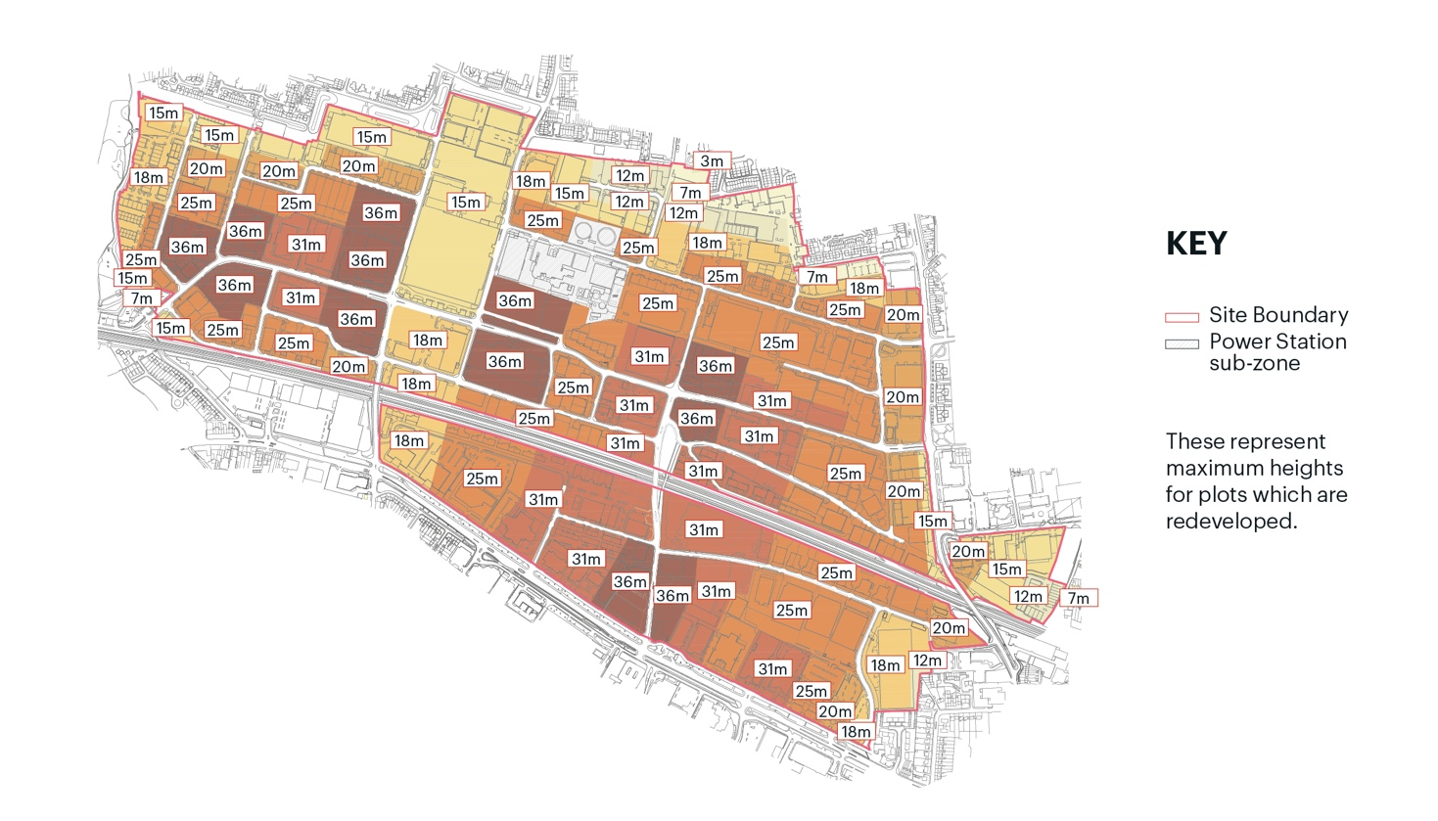
PERMITTED BUILDING HEIGHTS
A Building Heights Plan has been prepared which controls the maximum height of new buildings constructed under the SPZ.
A primary focus of the new SPZ is the development of taller industrial buildings in a planned and controlled manner.
With no new development land available on the Slough Trading Estate, the new SPZ will encourage a more efficient approach by intensifying the use of the existing land available. With the demand for housing a key priority for Slough, many commercial sites in the town have been redesignated for new homes resulting in a greater demand for industrial space. Through the new SPZ, the Slough Trading Estate will aim to capture that demand by delivering new and taller industrial schemes, that will be design-led
to enhance the character and appearance of the Estate.
136 Edinburgh Avenue (computer generated image)
SEGRO V-Park Leigh Road (computer generated image)
The proposed maximum building heights vary across the Estate and range from three metres (close to residential boundaries) to 36 metres (closer to the heart of the Estate). These recommended height parameters have been reached following thorough studies and research that follow industry recognised standards, and consider the following factors:
The scale and character of neighbouring buildings
Building heights will be restricted to three metres where development is next to existing residential areas, higher along the Bath Road and major thoroughfares such
as Buckingham Avenue, and highest in the centre of the Estate (maximum 36 metres).
The impact on important views in the area
Heights across the Estate have been set to ensure that the tops of newly developed buildings do not break the existing skyline of the woodland backdrop of the upper Thames Valley in views looking across the valley from the north
– in particular from Windsor Castle.
Heights have been set to frame local views from the grass mound at Kennedy Park across the valley to the countryside south of Slough.
Impact on neighbouring residents’ natural light levels
A technical exercise has been undertaken to make sure good levels of daylight and sunlight are achieved in homes and gardens surrounding the Estate.
PROPOSED BUILDING HEIGHTS TO VARY FROM
3M–36M
Here are some buildings you might recognise for context at different heights

Slide 7
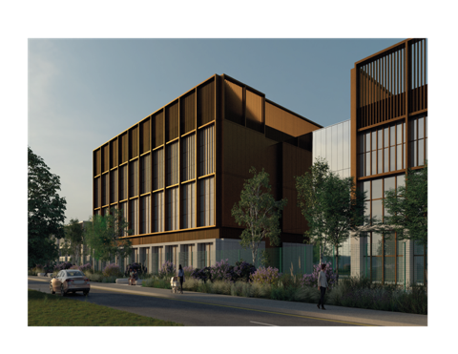
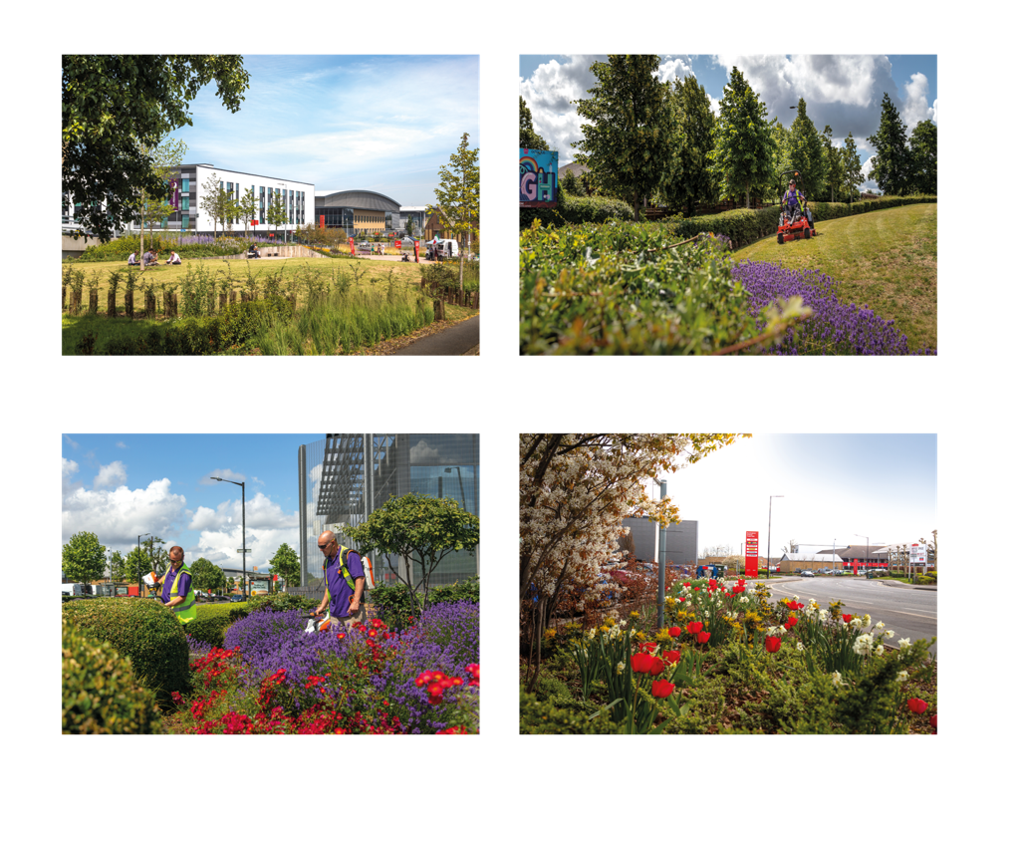
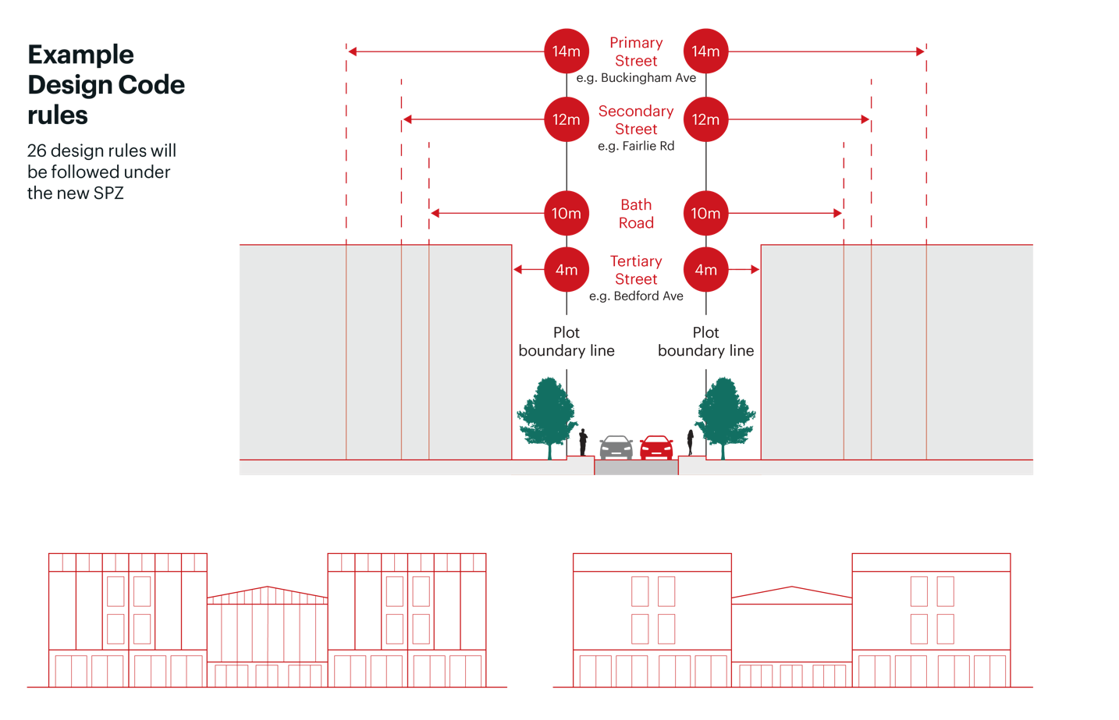
DESIGN QUALITY
LANDSCAPE & BIODIVERSITY
The Design Code includes requirements for all new developments to deliver a minimum of 6% of the development site as green space. The green space will include hedgerows and trees and will typically be located at the front of the building to improve the environmental quality of the building, enhance biodiversity, and create a more attractive frontage for pedestrians and passers-by.
In addition to landscape requirements for every new development, new pocket parks will be created on
the Estate, which will provide outdoor space for employees and visitors to enjoy. These pocket parks will be located at the junction of Weston Road and Buckingham Avenue and along Leigh Road, providing a green connection between the existing Leigh Road Park and the Buckingham Centre.
Over the period of the new SPZ, the above measures will mean that biodiversity levels will be 10% higher that they are today.
Bath Road
A Design Code has been produced to promote best-in-class design and sets out requirements which newly
developed buildings must comply with.
The Design Code has been adapted to respond to the different locations and characteristics of the Estate. For example, on prominent and busy thoroughfares like Bath Road, Farnham Road. Leigh Road and Buckingham Avenue, new developments will be set back from the street and will sit behind a generous bank of trees and green space.
The Estate location and road types will be considered when building designs are produced and the building entrance and office locations are planned, to ensure frontages look active and more attractive.
Taller building set back distances from the street
Leigh Road Pocket Park
Leigh Road Pocket Park
For larger buildings over 10m, the Design Code requires changes in form, architecture and building material to manage the scale of development and ensure buildings are visually interesting. The design rules also vary depending on the scale of development.
On minor roads within the Estate, like Yeovil Road and Malton Avenue, building architects will have slightly more flexibility in how buildings and spaces are designed.
Estate boundary landscaping
Estate boundary landscaping

Slide 8
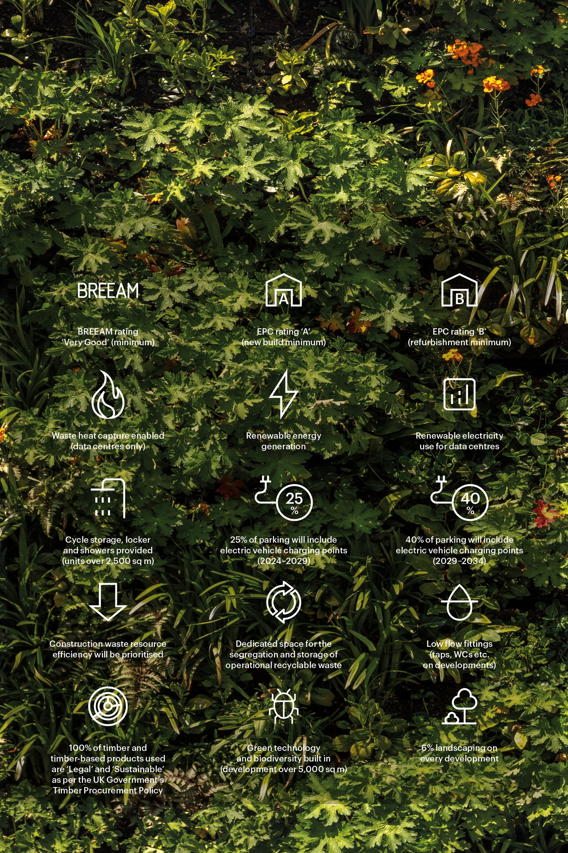
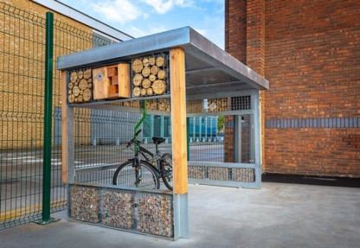
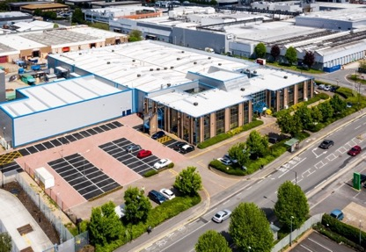
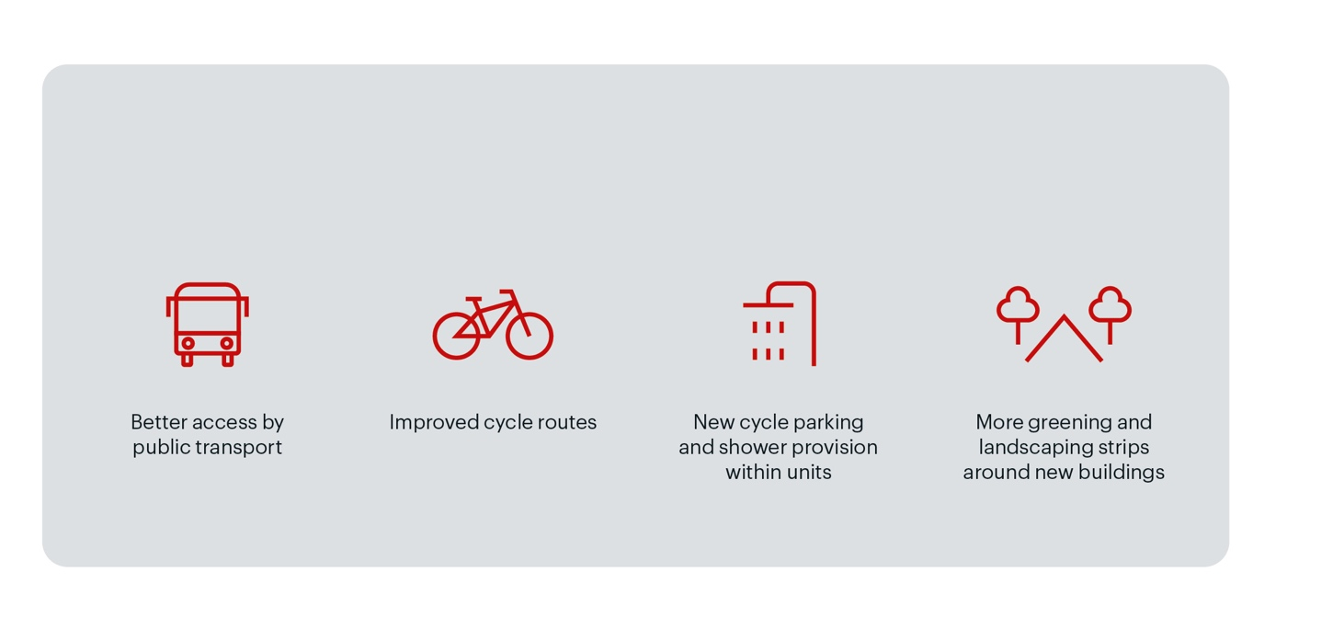
BUILDING SUSTAINABILITY
TRAFFIC & MOVEMENT
Sustainability measures under the SPZ include:
The new SPZ scheme includes the ‘cap’ on car parking, that also existed under the current 2014–2024 SPZ. This helps to control the number of employees and visitors traveling to and from the Estate to help minimise traffic congestion.
Despite the proposed increase in the heights of buildings enabling more industrial space, peak time traffic movements are expected to remain static over the period of the new SPZ.
The ability to ‘cap’ the number of car parking spaces up until 2034 is achievable due to the changing occupier mix driven by market demands.
Demand for office space, for example, in ‘out of town’ locations, such as Slough Trading Estate, is falling. Over the last 5 –10 years, there has been a steady exit of office occupiers on the Estate and along the Bath Road as companies seek to consolidate their business, improve productivity and drive cost savings, whilst identifying destinations which offer excellent public transport links and high levels of local amenities. Major employers such as LG, Ipsen, Black & Decker, and Research in Motion have all departed the Estate whilst Virgin Media O2 has announced its decision to relocate its Bath Road HQ to Paddington.
Whilst the loss of these major employers is a blow to the local economy, it provides an opportunity to redevelop the offices and attract new industrial-focused customers that are less dependent on high levels of car parking for staff. This means that car parking levels can remain relatively static over the next 10 years, despite increasing the capacity of industrial space across the Estate.
160–161 Bestobell Road
Buckingham Avenue
It is recognised that large scale logistics facilities can lead to increased levels of traffic movements that will need to be addressed to mitigate any impact on the local road network. Therefore, a restriction has been set on the amount of floorspace that can be constructed under the new SPZ. Over the new SPZ period of 10 years, no more than 55,000 sq m of large scale logistics space (defined as units larger than 2,500 sq m) can be built without the need for a planning application.
Alongside these controls, a comprehensive package of infrastructure improvements will enhance the Estate’s accessibility and environment, and support a healthier workforce and better air quality:

Slide 9
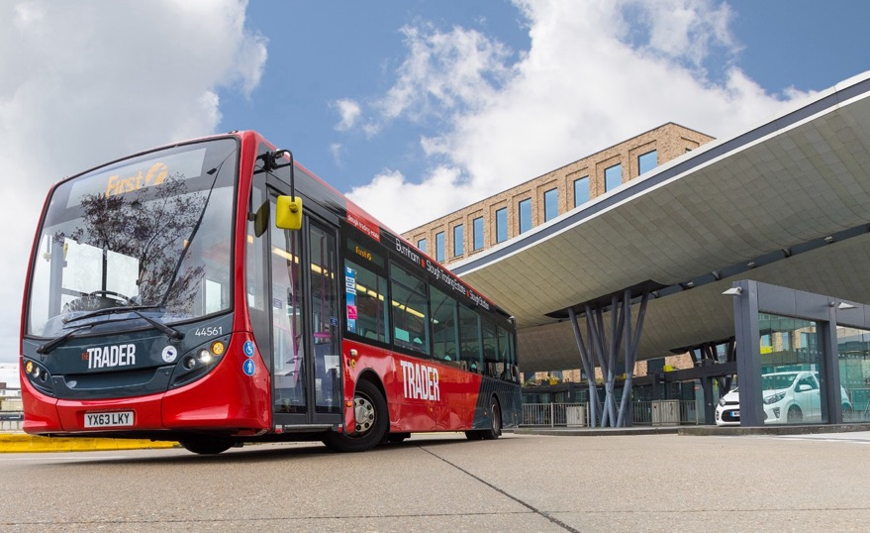
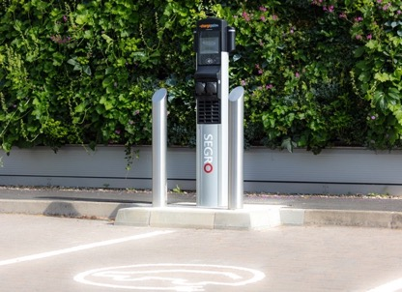
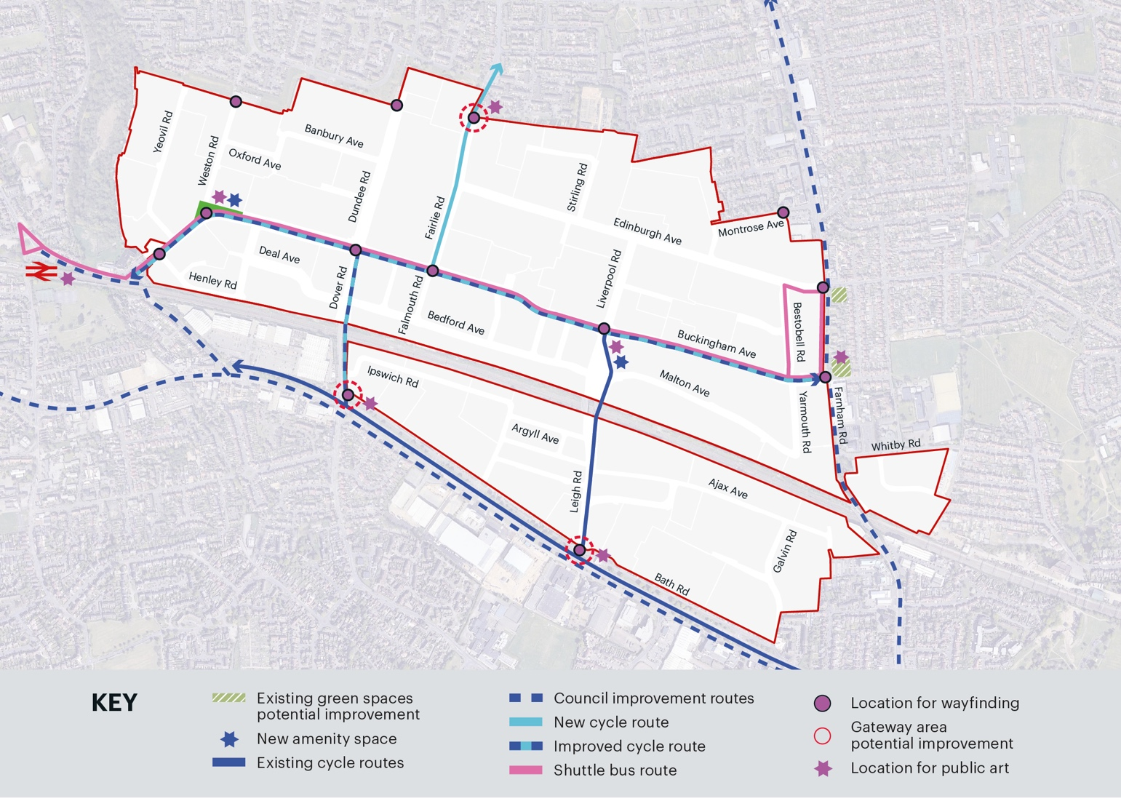
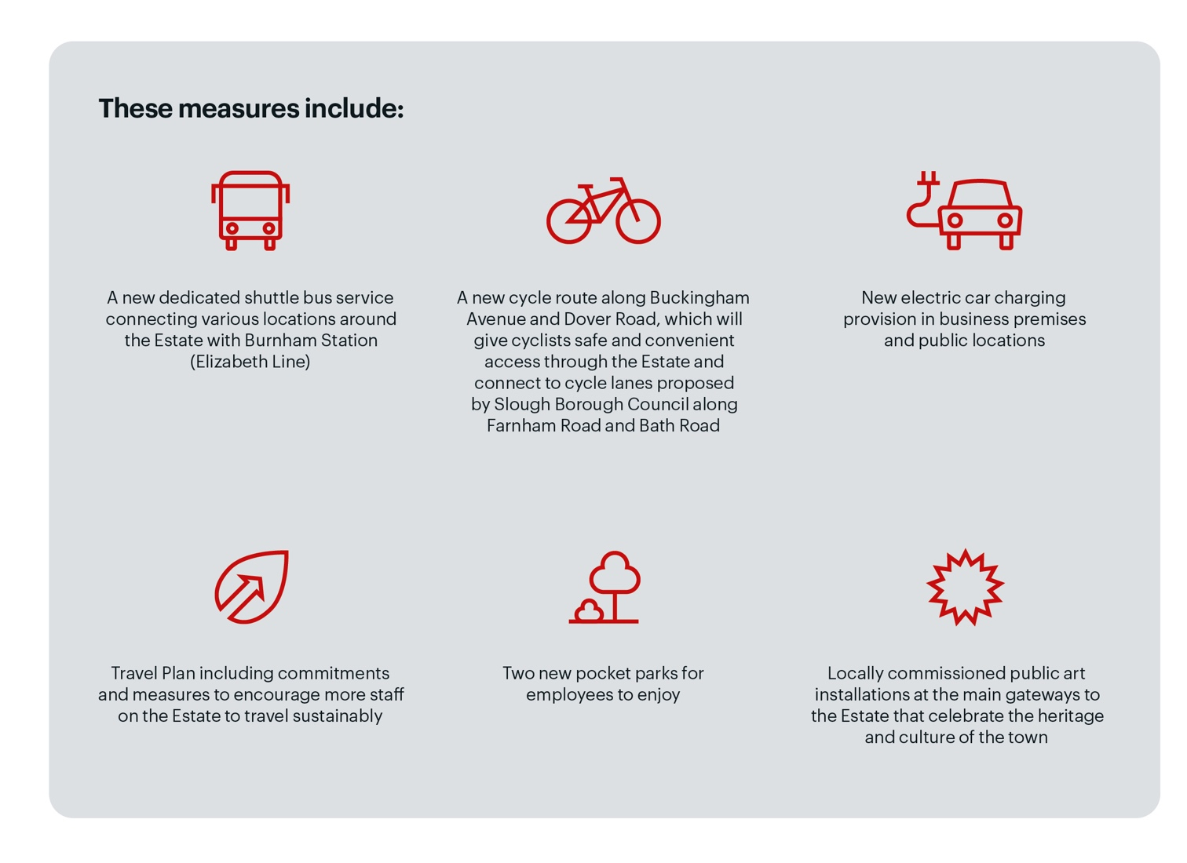
SUSTAINABLE INFRASTRUCTURE
The new SPZ will see a step change in sustainable and community infrastructure, which will be funded through a multi-million-pound commitment by SEGRO.
Well-designed sustainable infrastructure will have long-term economic, health and biodiversity benefits for Slough as well as supporting the productivity and growth of customers on the Slough Trading Estate.
Indicative shuttle bus image
EV Charger (indicative)
Indicative infrastructure improvements on the Slough Trading Estate

Slide 10
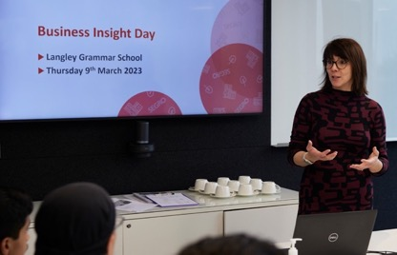
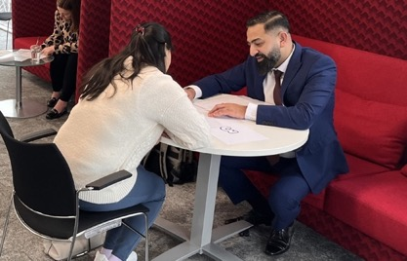
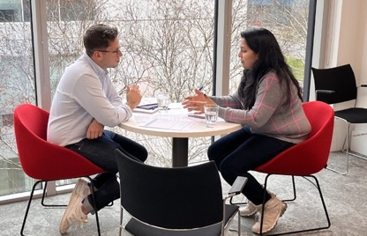
A SKILLED & SUSTAINABLE WORKFORCE
Over the period of the new SPZ, SEGRO will contribute a multi-million-pound investment towards local skill, training and economic development programmes in partnership with local and regional partners that would enhance the skill levels of residents so they can compete for better quality jobs, both on and off the Estate.
Student education programme attendee
To ensure the employment plan meets the needs of all parties, SEGRO will work with Slough Borough Council and local partners to fund programmes that could include:
A mapping exercise to identify the skills gaps of businesses and growth sectors, in the short, medium and long term, that will provide the data and insights to deliver an effective and demand-led skills plan.
A training programme that enables schools and residents to embrace the digital economy. Developing digital skills is critical both for job success and to participate fully in a digital society. Such skills include generic competencies like searching online, communication via email, or instant messaging, as well as the ability to use work-related online platforms.
An employment and job brokerage service that makes it easier for Estate customers to promote job opportunities and to source local talent.

Slide 11
slough.gov.uk/planningpolicy

